Slide 1

APPLICATION OF OOP PRINCIPLES IN DEVELOPING A SPORTS TEAM MANAGEMENT SYSTEM
CSA1103-Object Oriented Analysis and Design for information system
SUPERVISOR
Dr . R. DHANALAKSHMI (Professor)
Mrs.S.SARANIYA(Associate Professor)
PRESENTED BY
S.VIDDHIYA SHREE-192421188
I.THULASI-192421032
AKILANDESHWARI-192411106
Department of IT& CSE

Slide 2


ABSTRACT
To design and implement a Sports Team Management System using OOP principles.
To simplify management of teams, players, coaches, and match schedules.
To ensure data reusability, security, and easy maintenance through OOP concepts.
To apply Encapsulation, Inheritance, and Polymorphism in real-world software design.
To create modular, scalable, and user-friendly software for sports management.
To demonstrate how object relationships improve real-world system modeling.

Slide 3
INTRODUCTION
System that helps manage all activities related to sports teams in a local league.
Handles team creation, player registration, coach assignments, and match scheduling.
Uses Object-Oriented Programming (OOP) for better design and maintenance.
Allows admin and coaches to efficiently organize and track team performance.
Improves communication and coordination within the sports league.

Slide 4
PROJECT OBJECTIVES
Managing player and team data manually is time-consuming and error-prone.
Lack of centralized data storage for teams, players, and matches.
Significance
The Sports Management System provides a digital platform to efficiently manage sports activities, players, and events.
It helps reduce manual errors and paperwork by automating scheduling, registration, and reporting.
Scope
The system manages player registration, team creation, and tournament scheduling digitally.
It stores and organizes all player profiles, match results, and performance statistics in a centralized database.

Slide 5
METHODOLOGY OVEREVIEW
Requirement Analysis : The first step was to identify the needs of users, including players, coaches, and administrators.
Modules : Module 1- team and player management
Module 2: coach & training management
Module 3: match and schedule management
Implementation : The system was implemented using standard software development practices.
System Design : A user-friendly interface was designed for easy navigation by all types of users.
Testing : Unit testing was conducted to verify the correctness of individual modules.
Documentation: Proper technical documentation was prepared to describe the system’s architecture, modules, and database.

Slide 6
PROBLEM INDENTIFICATION
Manual Record Maintenance : Sports events, players, and team details are often recorded manually, leading to data loss, duplication, and errors.
Difficulty in Scheduling Matches and Events : Without automation, scheduling tournaments, practices, and matches can cause conflicts in timing and venue allocation.
Poor Player Performance Tracking : Coaches struggle to track players’ performance statistics over time due to lack of centralized data storage.
Inefficient Communication : Communication between players, coaches, and organizers is often scattered across multiple platforms, leading to miscommunication.

Slide 7
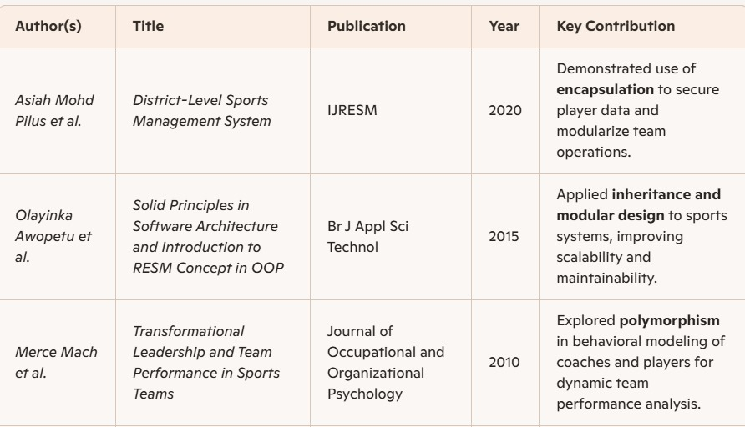
LITERATURE REVIEW

Slide 8
TOOLS AND METHODS
Encapsulation
Protects player/team data by using private attributes and get/set methods.
Prevents unauthorized access to internal data.
Inheritance
Player and Coach classes inherit common attributes (name, age) from Person. Promotes code reuse and reduces redundancy.
Polymorphism
Allows same function name (e.g., show_role()) to behave differently in Player and Coach.
Makes system flexible and extendable for new roles (e.g., Referee, Manager).

Slide 9
MODULE 1: TEAM AND PLAYER MANAGEMENT
This module focuses on managing all team and player-related data efficiently.
It helps in creating, updating, and viewing details of teams and players.
Each team can have multiple players with specific roles and positions.
The module uses OOP principles to organize players and teams as objects.
Encapsulation is used to protect player details from unauthorized access.
It allows the Coach or Admin to assign players to teams dynamically.

Slide 10
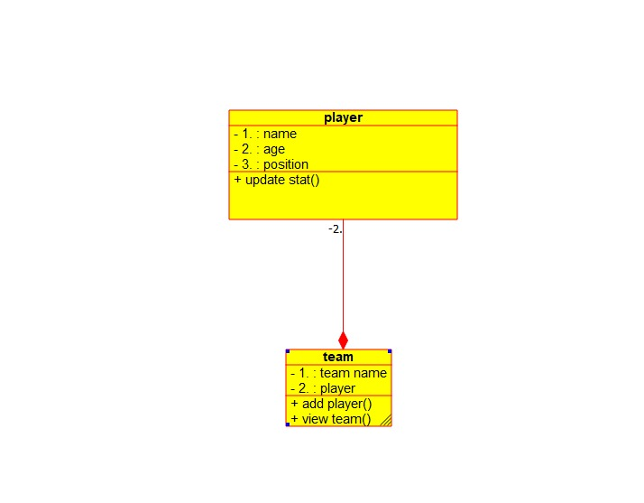
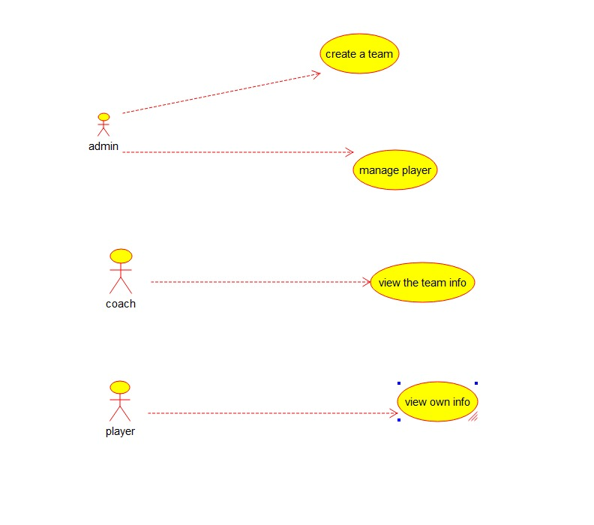
UML DIAGRAM
Class diagram
Use case diagram

Slide 11
MODULE 2: COACH & TRAINING MANAGEMENT
This module manages the details of coaches and their assigned training sessions.
It focuses on maintaining information about each coach’s experience, expertise, and assigned teams.
Coaches can schedule training sessions for teams or individual players.
It connects directly with the Team and Player Management module for data sharing.
The system uses OOP inheritance, where Coach inherits from a Person base class.
Each coach can manage multiple teams and plan customized training programs.

Slide 12
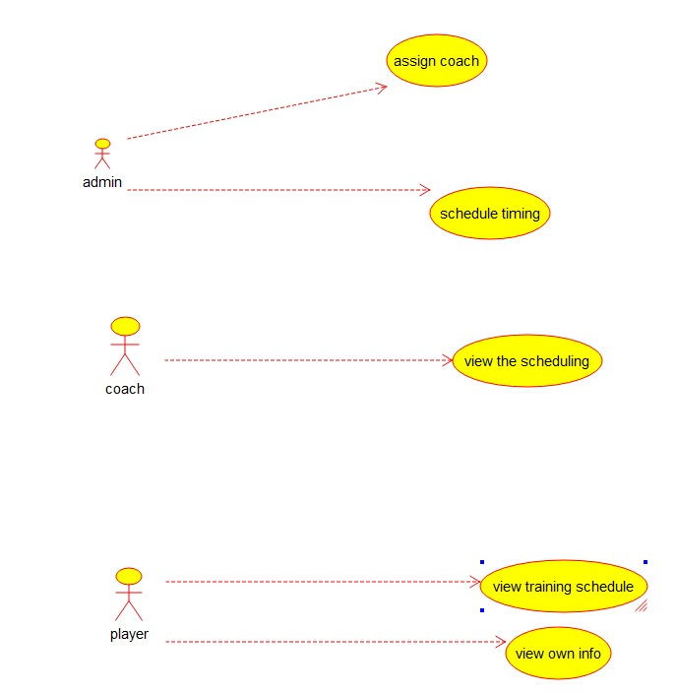
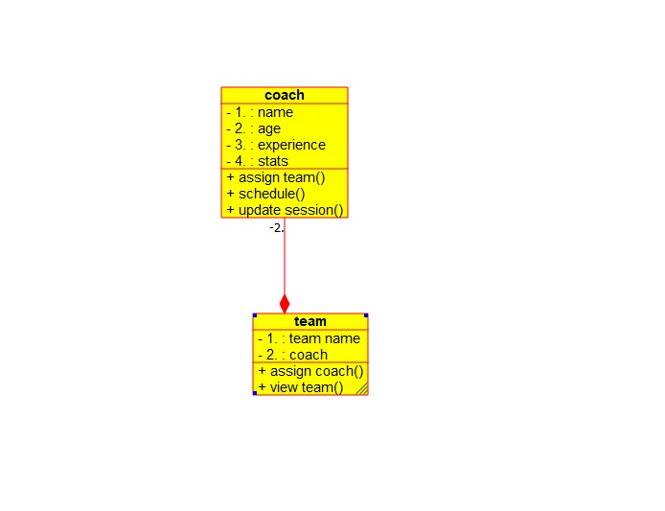
UML DIAGRAM
Class diagram
Use case diagram

Slide 13
MODULE 3: MATCH AND SCHEDULE MANAGEMENT
This module handles the creation and management of match schedules.
It connects with Team and Player Management to assign participating teams.
It also interacts with Coach and Training Management to avoid timing conflicts.
Each match includes details such as date, time, venue, and teams involved.
The system uses OOP polymorphism to handle different match types (league, knockout, friendly).It automates fixture generation based on team availability.

Slide 14
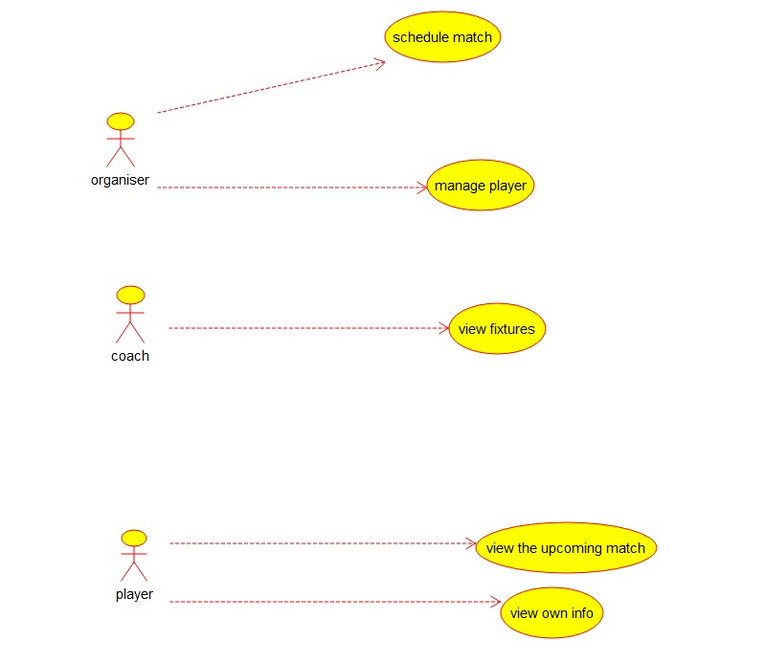
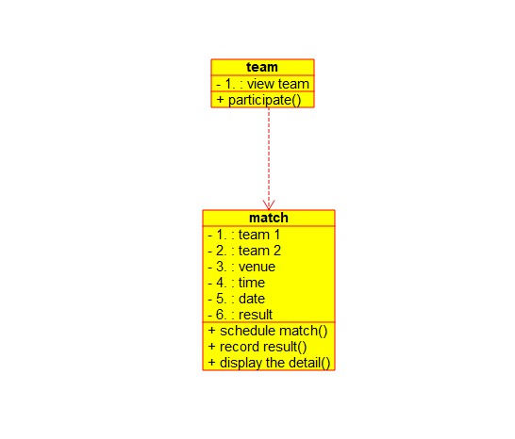
OUTPUT
Use case diagram
Class diagram

Slide 15
RESULT AND RECOMMENDATIONS
Evaluation of results:
The implementation of the Sports Management System successfully resolves the major issues faced in traditional sports administration.
It provides a centralized digital platform for managing players, teams, tournaments, and resources efficiently.
Recommendations:
Regular System Updates : Continuously update the system to include new features such as AI-based performance analysis and mobile access.
User Training : Provide proper training sessions for coaches, staff, and players to ensure smooth adoption of the system.

Slide 16
APPLICATIONS OF ENGINEERING AND ETHICAL STANDARDS
Applications of engineering standard
ISO/IEC 25010 – Software Quality:
Ensures reliability, usability, and maintainability of the system.
ISO/IEC/IEEE 12207 – Software Lifecycle Process:
Defines structured development, testing, and maintenance procedures.
ISO/IEC 27001 – Information Security Management:
Protects player, coach, and match data from unauthorized access.
Application of Ethical standard:
IEEE / NSPE Code of Ethics:
Promotes honesty, fairness, and responsibility in engineering.
ISO/IEC 27018 – Cloud Data Protection:
Ensures ethical handling of personally identifiable information (PII).

Slide 17
CHALLENGES ENCOUNTERED AND OVERCOME
Data Handling Complexity
Challenge: Managing large volumes of player and event data caused confusion and inconsistency.
Overcome: A centralized database was developed to store and retrieve all data efficiently.
User Interface Design
Challenge: Users found it difficult to navigate the initial interface.
Overcome: The UI was redesigned with simple menus and user-friendly layouts for easier access.

Slide 18
REFERENCES
Ian Sommerville, Software Engineering, 10th Edition, Pearson, 2015.
E. Balagurusamy, Object-Oriented Programming with C++, 7th Edition, McGraw-Hill, 2018.
Grady Booch, Object-Oriented Analysis and Design with Applications, 3rd Edition, Addison-Wesley, 2007.
Tutorials Point, Python OOP Concepts, https://www.tutorialspoint.com/python/python_classes_objects.html
GeeksforGeeks, Object-Oriented Programming in Python, https://www.geeksforgeeks.org/python-oops-concepts/

Slide 19
CONCLUSION & ENHANCEMENT
Conclusion
The Sports Management System effectively automates various sports-related activities and record keeping.
It simplifies player, team, and tournament management through a centralized platform.
Future Enhancement
Introduce a mobile application for instant access to schedules, results, and updates.
Add AI-based analytics to evaluate player performance and suggest improvements.

Slide 20
THANK YOU

